Slide 1
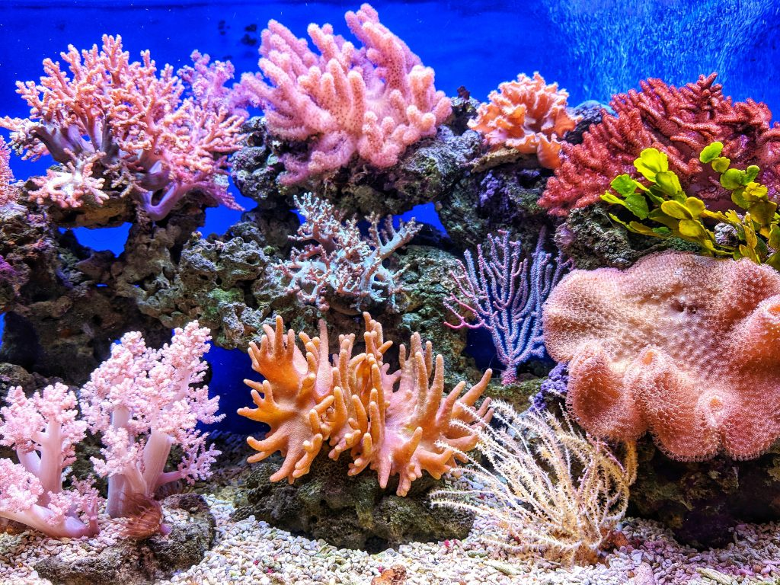
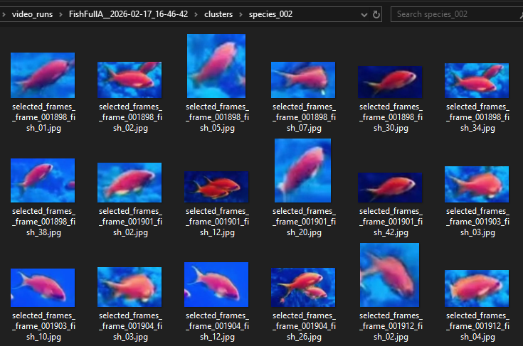
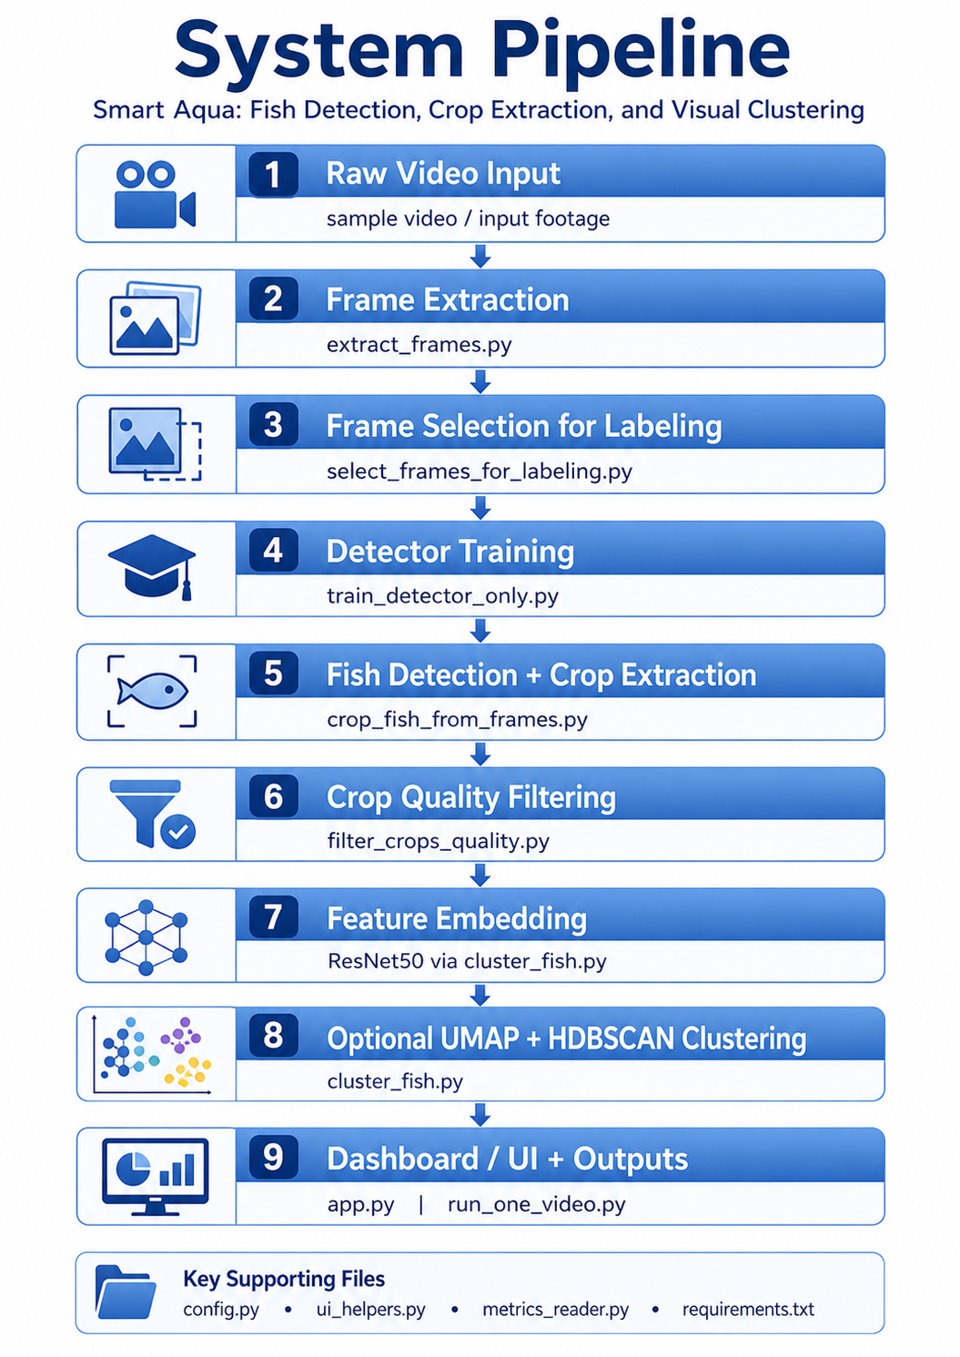
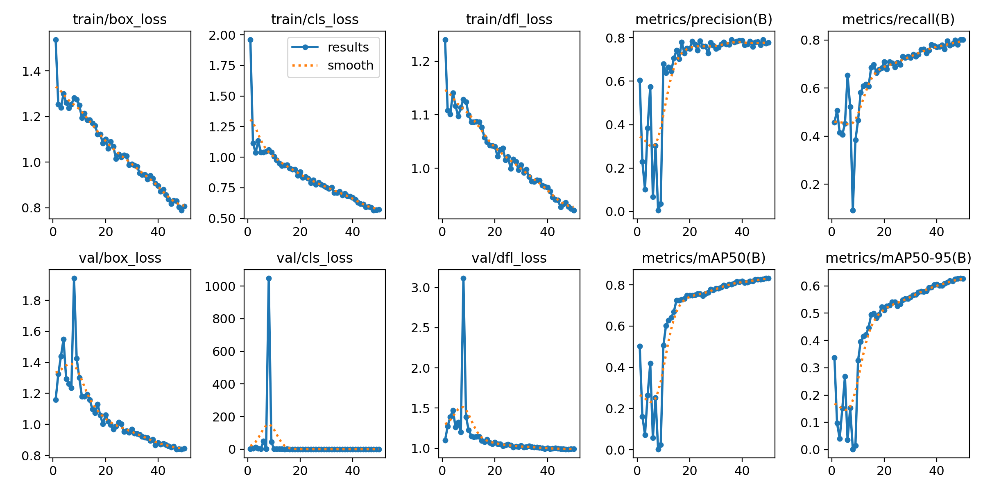
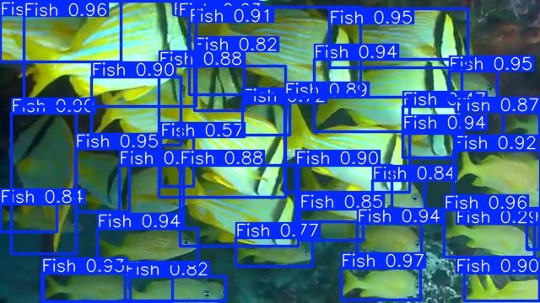
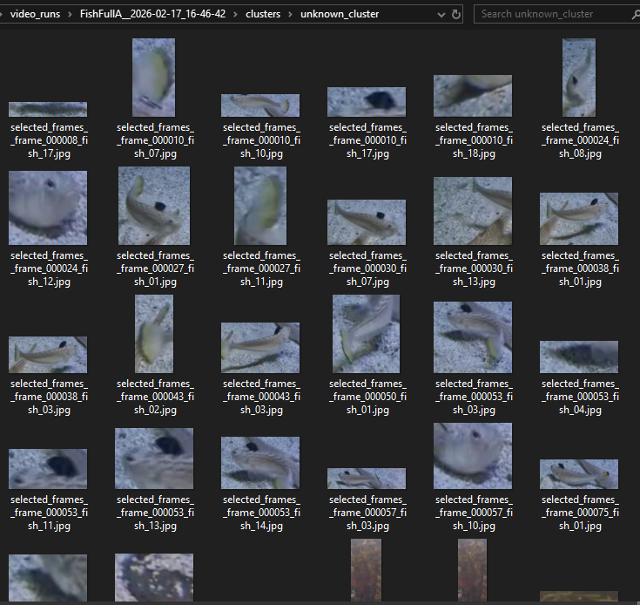
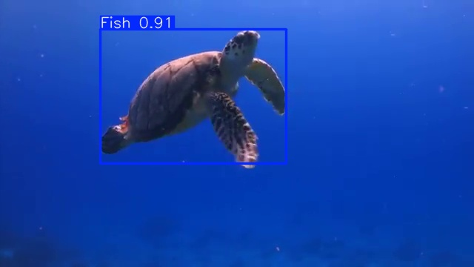
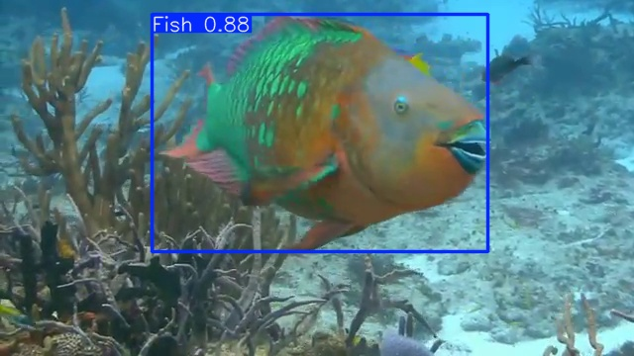
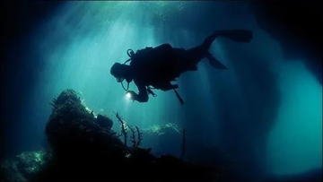
Smart Aqua: Fish Detection, Crop Extraction, and Visual Clustering
David Wilson
Introduction
Marine biodiversity monitoring traditionally relies on manual
annotation of underwater imagery, which is time-consuming and requires expert knowledge.
Recent advances in AI allow marine organisms
to be detected automatically from underwater images.
However, most existing systems rely on fully supervised
classification, requiring large labelled datasets.
This project explores whether unsupervised learning can
automatically group fish into clusters without
manual annotation.
Method
1. Fish Detection
Fish are detected using the YOLOv8 object detection
framework
2. Crop Extraction
Detected fish are extracted as individual image crops.
3. Image Filtering
Low-quality crops are removed based on:
Minimum bounding box size, Image sharpness, and Aspect ratio constraints
4. Feature Extraction
Each crop is converted into a numerical feature
representation using a pretrained AI.
Project Results
The YOLOv8 detection model achieved impressive performance
on the validation dataset.
Example Detection metrics:
Precision: 0.898
Recall: 0.8
mAP50: 0.871
mAP50-95: 0.651
These results indicate that the detector reliably
identifies fish within underwater scenes and provides
high-quality crops for clustering.
Project Aim
The goal of this project is to develop an AI capable of automatically grouping fish images into visually similar clusters.
Key objectives:
• Detect fish in underwater images using YOLOv8
• Extract fish crops from detected bounding boxes
• Generate deep visual embeddings from each crop
• Cluster fish using unsupervised learning
Training Results
Dataset
The dataset consists of underwater/aquarium fish imagery containing multiple fish appearances, sizes, and backgrounds.
Images include:
• Diverse fish sizes and shapes
• Varying lighting conditions
• Complex backgrounds such as coral and rocks
From the dataset: 80% training / 20% Validation
3240 training images after augmentation
272 validation images
Single “Fish” class used
10945 annotated fish instances
Conclusion
This project demonstrates the feasibility of combining
object detection with unsupervised learning to analyze
underwater fish imagery.
The developed pipeline successfully detects fish, extracts visual embeddings, and groups fish into clusters
based on visual similarity.
Although challenges remain in separating
clusters precisely, the approach shows
promise for automated marine biodiversity
analysis.
Challenges
Background contamination
Bounding boxes sometimes contain large portions of
background such as coral, rocks, or water.
Lighting variation
Underwater environments produce strong color shifts
that affect visual similarity between fish images.
Several iterations of
model training and
parameter tuning
were needed to
improve detection
Reliability
Future Work
Several improvements could further enhance clustering
performance.
• Self-supervised feature extractors such as DINOv2
• Fish segmentation to remove background pixels
• Color normalization for underwater imagery
• Fine-tuning embeddings on marine datasets

